Slide 1


Quantum-resistant QKD protocol-based Messaging Encryption
IFT 520: Advanced Information System Security
Hitesh Koneru
Rohit Gangadhar Pari
Jananiya Sadasivam
Kavyashree Murugesan
Presented By Hitesh Koneru

Slide 2
INDEX
INTRODUCTION
PROBLEM STATEMENT
SCOPE
IMPLEMENTATION
DEMO
Presented By Hitesh Koneru

Slide 3

Problem Statement
As quantum computing technology continues to advance, the confidentiality of information transmitted online faces a serious threat. Traditional encryption methods will soon be vulnerable to attacks from quantum computers.
To address this critical issue, our project aims to implement an innovative Quantum Key Distribution (QKD) protocol that will fortify the security of digital communication systems. Harnessing the unique properties of quantum mechanics, QKD allows two parties to securely exchange cryptographic keys that can encrypt messages with near impenetrable privacy.
By integrating this cutting-edge quantum-resistant technique into communication infrastructure before the quantum era arrives, we endeavor to safeguard society’s valuable digital assets from the immense computing power of quantum devices.
In short, our goal is to future-proof online communication through quantum technology, ensuring that the exchange of sensitive information over the internet remains private even in an age of unprecedented processing capabilities. We seek to protect the confidential integrity of digital interactions as quantum progress continues apace.
Presented By Hitesh Koneru

Slide 4

Scope
Why Quantum encryption is important?
The provided code implements a basic simulation of Quantum Key Distribution (QKD) using the Qiskit framework. The design process involves several key steps to establish a secure communication channel between a sender and a receiver. The simulation begins by setting the number of qubits to 15 and initializing quantum and classical registers for both the sender and receiver. The sender generates a random secret key, converts it to binary representation, and encodes it onto the quantum circuit by applying X gates to the corresponding qubits.
Subsequently, the sender randomly selects polarizations ('↕', '⤢', '↔', '⤡') for each qubit based on a generated random axis. Hadamard gates ('H') are applied to certain qubits, altering their states. The chosen polarizations are recorded in the sender_secret_key_polarisation_table. This table essentially represents the encoded information about the secret key.
The final step involves printing the polarizations of the sender's secret key. Overall, the design process encompasses the initialization of quantum registers, the generation and encoding of a secret key, and the assignment of random polarizations to the qubits. This simulation lays the groundwork for further development of a QKD protocol and provides insights into the quantum state preparation and polarization selection aspects of secure key distribution.

Slide 5


TOOLS USED
Qiskit:
Qiskit is the main quantum computing framework used in the code. It provides a comprehensive set of tools and functionalities for quantum circuit design, simulation, and execution on quantum devices. Key Qiskit modules and classes utilized in the code include:
NumPy:
NumPy is a powerful numerical computing library in Python. In this code, NumPy is employed for random number generation and binary representation of the sender's secret key. The key NumPy functions include:
Matplotlib:
Matplotlib is a widely-used plotting library in Python. In this code, Matplotlib is used for inline visualization of the final polarization of the sender's secret key.
Presented By Jananiya

Slide 6
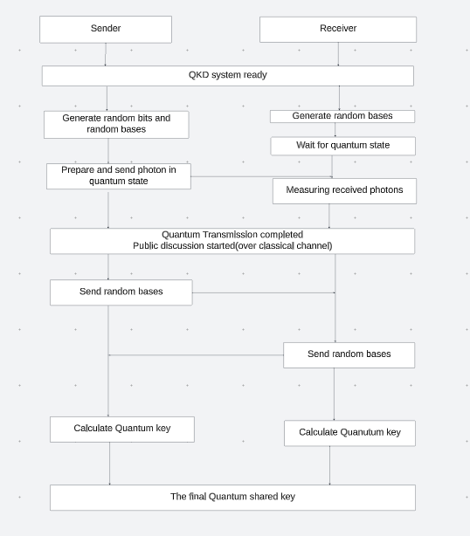
FLOW CHART
Presented By Kavyashree Murugesan

Slide 7
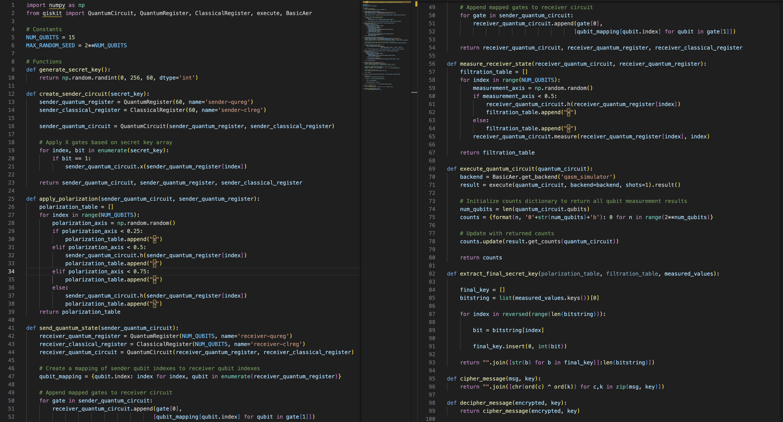
CODE

Slide 8
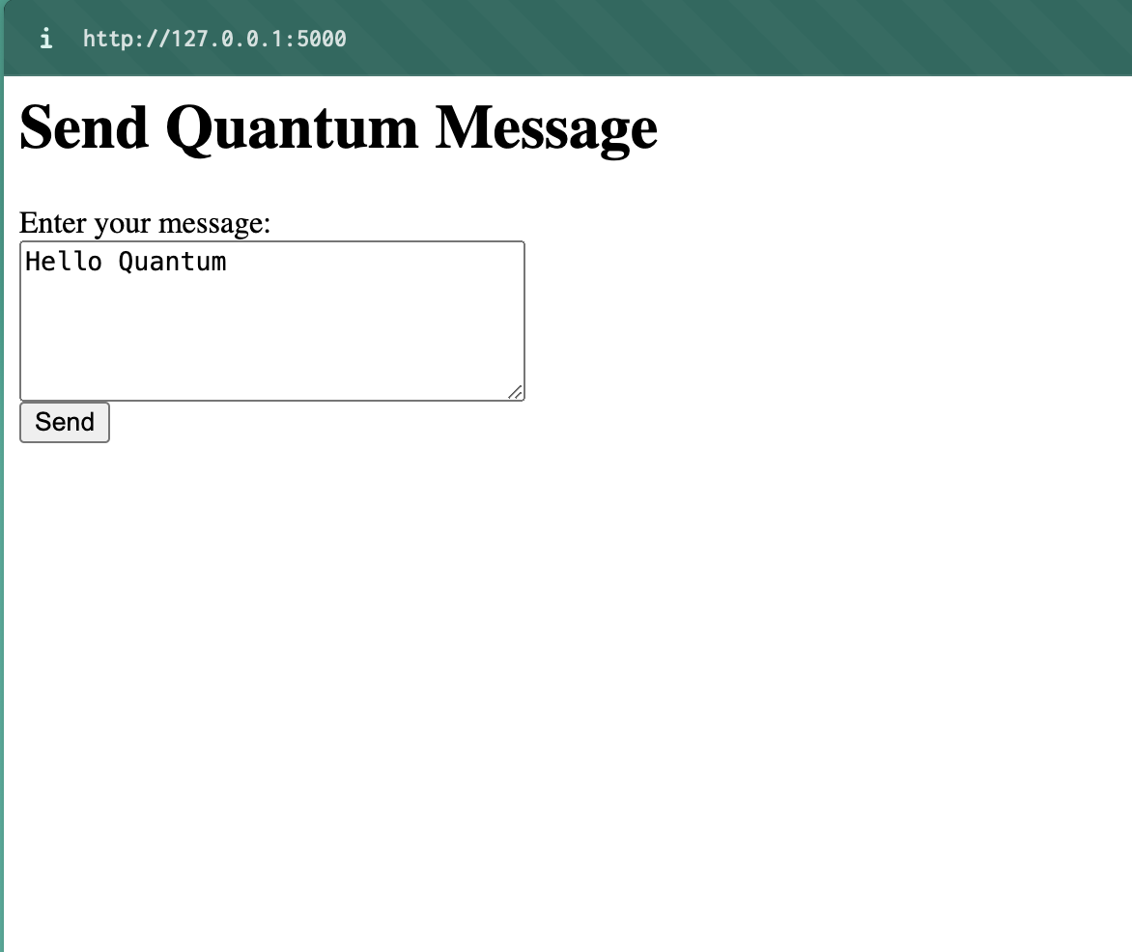
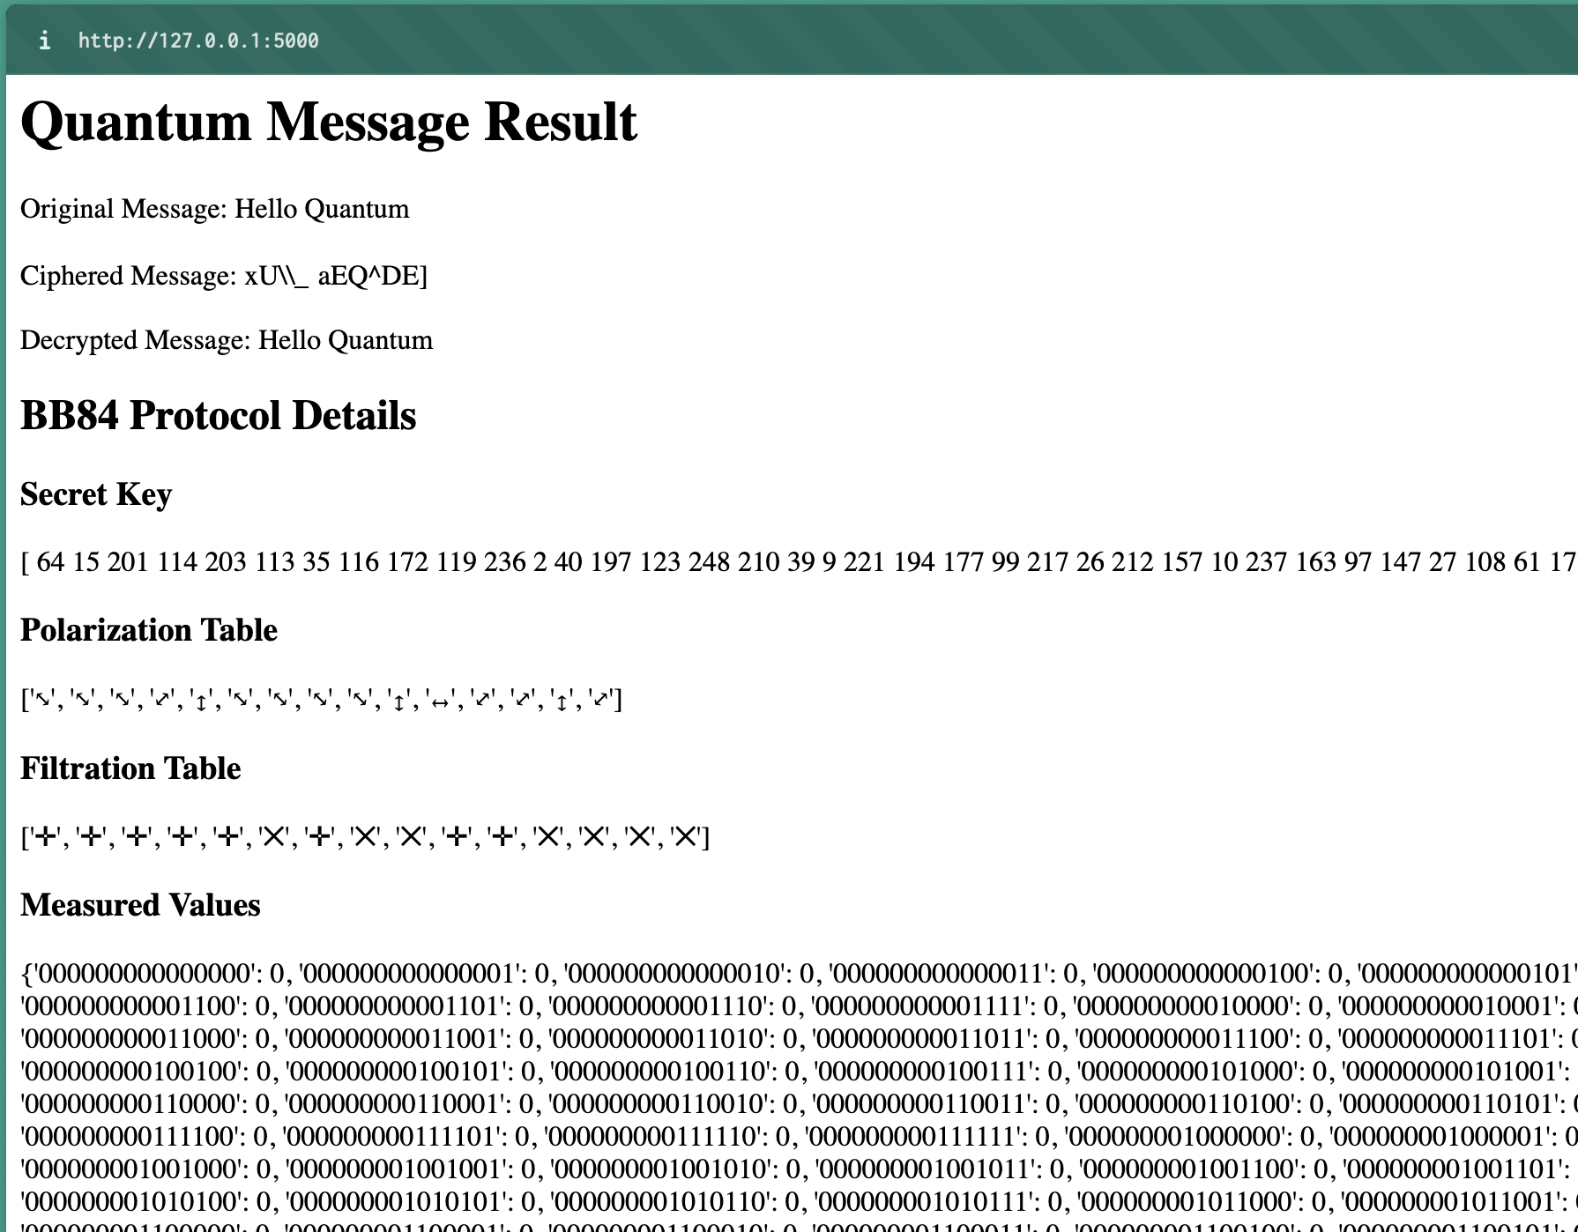
OUTPUT

Slide 9
THANK YOU

